Slide 1
Financial Markets and Securities Session 5 Stock market
Notes:
Introduction:

Slide 2
Investing in Stocks
Represents ownership in a firm
Earn a return in two ways
Price of the stock rises over time
Dividends are paid to the stockholder
Stockholders have claim on all assets
Right to vote for directors and on certain issues
Two types
Common stock
Residual claim
Right to vote
Receive dividends
Preferred stock
Priority over common
Receive a fixed dividend
Do not usually vote

Slide 3
How Stocks are Traded?
Organized exchanges
NYSE is best known, with daily volume around 4 billion shares, with peaks at 7 billion.
Transparent (pricing, reports), concentration of buyers/sellers, standardized, no settlement risk (clearing house),
Listing requirements exclude small firms
Over-the-counter markets
Tailor made (non standard) transactions, could be cheaper, no reporting and listing requirements, no standard settlement (could be more risky)

Slide 4
Equity Markets
Common stock
Residual claim
Limited liability
Preferred stock
Priority over common
Fixed dividends
Tax treatment
Special voting right, dividend pref, fix dividend, „Golden shares”
Depository receipts
Foreign companies’ listings

Slide 5
Valuation: Fundamental Analysis
Fundamental analysis models a company’s value by assessing its current and future profitability.
The purpose of fundamental analysis is to identify mispriced stocks relative to some measure of “true” value derived from financial data.

Slide 6
Models of Equity Valuation
What effect the market prices and valuation?
Basic Types of Models
Balance Sheet Models - Calculation
Dividend Discount Models - Calculation
Price/Earnings Ratios – Comparative
Free Cashflow Models - Calculation
Estimating Growth Rates and Opportunities

Slide 7
I. Balance Sheet Models
Book value: The net worth of common equity according to a firm’s balance sheet
Value of common equity on the balance sheet
Limitation: historic and not current value
Some assets such as brand name or specialized skills are not on a balance shee
Liquidation value: Net amount that can be realized by selling the assets of a firm and paying off the debt.
Firm becomes a takeover target if market value stock falls below this amount, so liquidation value may serve as floor to value
Replacement cost: Cost to replace a firm’s assets.
Market value
Current market value of assets - current mv of liabilities
may be difficult to ascertain
Market value based on stock price
Better measure than book value of the worth of the stock to the investor.
Notes:
Book value: companies with asset value (utility), Liquidation value: risk based approach, Replaicement cost: like appartment renting
Book value is not a floor for market price…
When the arey trading blow the book value? Amikor rövid távon további kockázatra vagy esésre számítanak vagy a book value nem lett átértékelve… nagyon régi értékelést mutat
Liquidation value: A corporate trader would find it profitable to buy enough shares to gain control and then actually liquidate because the liquidation value exceeds the value of the business as a going concern. Gordon Geco from the film

Slide 8
Intrinsic Value vs. Market Price
The return on a stock is composed of dividends and capital gains or losses.
The expected HPR may be more or less than the required rate of return, based on the stock’s risk.

Slide 9
Required Return
CAPM gives the required return, k:
If the stock is priced correctly, k should equal expected return.
k is the market capitalization rate.

Slide 10
Intrinsic Value vs. Market Price
Intrinsic Value: The present value of a firm’s expected future net cash flows discounted by the required rate of return.
Self assigned Value
Variety of models are used for estimation
Market Price
Consensus value of all potential traders
Trading Signal
IV > MP Buy - Undervalued
IV < MP Sell or Short Sell - Overvalued
IV = MP Hold or Fairly Priced – Fairly valued
Usually the market price of the stock reflects other valuation elements like macro risk, sectorial issues
Notes:
In market equilibrium, the current market price will reflect the intrinsic value estimates of
all market participants.
How to predict future cashflow? (build up models, asking the management, and follow the company related macro news)

Slide 11
Intrinsic Value
Intrinsic Value
The cash flows on a stock are?
Dividends (D_{t})
Sale price (P_{t})
Intrinsic Value today (time 0) is denoted V₀ and for a one year holding period may be found as:
Notes:
Which years dividend, k is expected return or required return!!! Market return
Future dividend as future cash flow is disconted

Slide 12
Basic Dividend Discount Model
Intrinsic value of a stock can be found from the following:
What happened to the expected sale price in this formula?
Why is this an infinite sum?
Is stock price independent of the investor’s holding period?
V₀ = Intrinsic Value of Stock
D_{t} = Dividend in time t
k = required return
D
D
D
+
P
V
=
1
+
2
.
.
.
+
N
N
0
(
1
+
k
)
1
(
1
+
k
)
2
(
1
+
k
)
N
P_{N} = the expected sales price for the stock at time N
N = the specified number of years the stock is expected to be held
Notes:
What happened to the expected sale price in this formula?
The expected sale price is simply the present value at that point in time of all future dividends.
Why is this an infinite sum? Because stocks are infinitely lived.
Is stock price independent of the investor’s holding period?
Yes, and this is a crucial point. Many uninitiated believe that because of the growth of day traders, and rapid stock trading that stock prices are determined based on short term prospects of the firm. If this model is correct, then this conclusion is untrue. We have had large scale failures in corporate governance and reward systems that promoted short term thinking by managers.
Required return is not risk free rate, bond rate…it is what we require from the investment

Slide 13
No Growth Model: Example
Stocks that have earnings and dividends that are expected to remain constant
Calculation: Perpetuity, with Cash flow = D, and discount rate = k
Preferred Stock
A preferred stock pays a $2.00 per share dividend and the stock has a required return of 10%. What is the most you should be willing to pay for the stock?
D
V
=
o
k

Slide 14
Constant Growth Model
Use: Stocks that have earnings and dividends that are expected to grow at a constant rate forever
A common stock share just paid a $2.00 per share dividend and the stock has a required return of 10%. Dividends are expected to grow at 6% per year forever. What is the most you should be willing to pay for the stock?
g = constant perpetual growth rate
Calculation: growing perpetuity
Dividend = Earnings per share multipled by dividend payout ratio
Earnings (100%) = Dividend payout ratio + Reinvested ratio (‘b’, also called plowback ratio)

Slide 15
Prices and Inv. Opportunities
g = growth rate in dividends is a function of two variables:
ROE = Return on Equity for the firm
b = plowback or retention percentage rate
(1- dividend payout percentage rate)
g increases if a firm increases its retention ratio and/or its ROE
If you have higher investment project return than the required rate of return than it is worth to invest than pay out dividend.
Lowers the dividend pay out ratio=Percentage of earnings paid out as dividends.
How the stock price will react? Fall or gain??
Notes:
Although dividends initially fall under the earnings reinvestment policy, subsequent growth in the assets of the firm because of reinvested profits will generate growth in future dividends, which will be reflected in today’s share price. All is true if the company clearly communicate the high reinvestment reason and return expectation. Important to understand that investors want is growth. Growth is not the same as growth potential!! Reinvestment only increase the value of the investment if expected return is higher than the average.
Predictable dividend policy by predictable eranings (utility sector, high dividend, lower growth), non predictable dividend (growth stocks, less dividend, high capital gain, when stockholders take the money)
Semi conductors or IT development companies has high retaining earnings (plowback ratio)

Slide 16
DDM Implications
The constant-growth rate DDM implies that a stock’s value will be greater:
The larger its expected dividend per share.
The lower the market capitalization rate, k.
The higher the expected growth rate of dividends.
The stock price is expected to grow at the same rate as dividends.

Slide 17
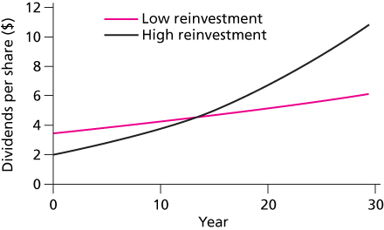
Dividend Growth for Different . Earnings Reinvestment Policies
(for a given ROE)
High reinvestment increases stock price only if ROE > k

Slide 18
Growth+No Growth Components
The value of the firm equals the value of the assets already in place, the no-growth value of the firm,
Plus the NPV of its future investments,
Which is called the present value of growth opportunities or PVGO.
D
(
1
+
g
)
o
E
PVGO
=
−
1
(
k
−
g
)
k
PVGO = Present Value of Growth Opportunities
E₁ = Earnings Per Share for period 1
Notes:
In real life corps. are not growing constantly, rather they have different growth in different life cycle. To value companies with temporarily high growth, analysts use a multistage version of the dividend discount model. Dividends in the early high-growth period are forecast and their combined present value is calculated. Then, once the firm is projected to settle down to a steady growth phase, the constant growth DDM is applied to value the remaining stream of dividends.

Slide 19
Comparative analysis- P/E Ratio
The ratio of a stock’s price to its earnings per share.
P/E Ratios are a function of two factors
Required Rates of Return (k)
Expected growth in Dividends
Current Price
Next (expected) Dividend
Uses
Relative valuation
Extensive use in industry
P
0
E
1
Notes:
Forecasting earnings is challenging, somethimes unpredictable.
P/E varies in industries and over time.
High growth expectation of the tech stocks push up the P/E ratios
Good impression, but P/E is not everything – you have to look into it what is the reason behind the high or low P/E…. Company or sector specific or country specific

Slide 20
Pitfalls in Using P/E Ratios
As earnings is an accounting term
Flexibility in reporting makes choice of earnings difficult. Earnings Management (Depreciation, transfer fee within the company)
Choice of Accounting standards
Inflation
A high P/E implies high expected growth, but not necessarily high stock returns,
Wich year earnings is calculated: historic or predicted (forecasted). Reported earnings fluctuate around the business cycly. This year’s earnings vs. long term earnings expectation

Slide 21
P/E Ratios
IT Industy P/E ratios
P/E Ratios by Industries
IBM company research paper

Slide 22
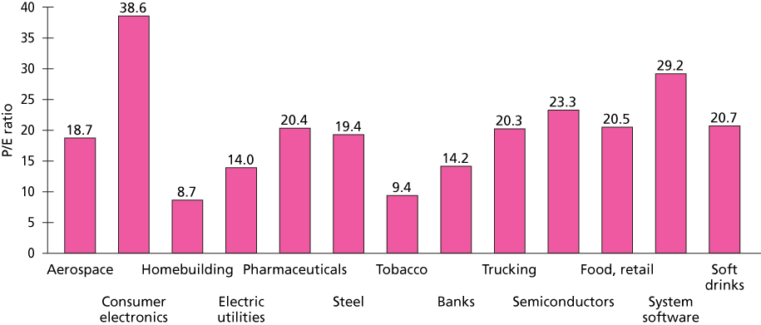
P/E Ratios

Slide 23
Other Valuation Ratios
Price-to-book: fundamental value and price
.
Price-to-cash flow: earnings can change for y-t-y because of acc. techniq. (oparational CF or free CF)
Price-to-sales: startup, so there is no earnings

Slide 24
Free Cash Flow Approach
Discounted Cash Flow valuation: discounting the future net cashflow with expected rate of return and using a constant grow later
Value the firm by discounting free cash flow at WACC.
Free cash flow to the firm, FCFF, equals:
After tax EBIT
Plus depreciation
Minus capital expenditures
Minus increase in net working capital

Slide 25
Discounted Cashfow
valuation

Slide 26
DCF Valuation: The Steps
Estimate the discount rate or rates to use in the valuation
Discount rate can be either a cost of equity (if doing equity valuation) or a cost of capital (if valuing the firm)
Discount rate can be in nominal terms or real terms, depending upon whether the cash flows are nominal or real
Discount rate can vary across time.
Estimate the current earnings and cash flows on the asset, to either equity investors (CF to Equity) or to all claimholders (CF to Firm)
Estimate the future earnings and cash flows on the firm being valued, generally by estimating an expected growth rate in earnings.
Estimate when the firm will reach “stable growth” and what characteristics (risk & cash flow) it will have when it does.
Choose the right DCF model for this asset and value it.

Slide 27
DCF Valuation: The Steps
Estimate Cashflows
Current cashlow and earnings
Future cashlow and earnings
Free Cash Flow to the Equity (FCFE) the cash is available to pay to a company's equity shareholders after accounting for all expenses, reinvestment, and debt repayment.
Estimate Growth Profile & Growth Rates
1 stage, 2 stage
Calculate Discount Rate
Cost of Equity, CAPM
Calculate the Terminal Value
Calculate fair value of company and its equity

Slide 28
DCF - pros, cons
Advantages
The most sound method of valuation.
Forward-looking and depends more future expectations rather than historical results.
Inward-looking, relying on the fundamental expectations of the business or asset, and is influenced to a lesser extent by volatile external factors.
Focused on cash flow generation and less affected by accounting practices/assumptions.
Allows different operating strategies to be factored into the valuation.
Allows different components of a business or synergies to be valued separately.
Advantages
The accuracy of the valuation determined using the DCF method is highly dependent on the quality of the assumptions of FCF, TV, and discount rate. DCF usually expressed a range of values rather than a single value. It is common to run the DCF for different scenarios, as a base case/optimistic /pessimistic case to gauge the sensitivity of the valuation to various operating assumptions
The TV often represents a large percentage of the DCF valuation. Valuation is largely dependent on TV assumptions rather than operating assumptions for the business or the asset.

Slide 29
Thank you for your attention!
Any Questions?

